Slide 1
1. Introduction to Intrusion Detection
Intrusion Detection Module
Stephen Huang
Department of Computer Science
University of Houston
Notes:
Version 1, July 1, 2014

Slide 2


Contents
Introduction of IDS
IDS Characteristics
Network Attacks

Slide 3
Cyber Security Is Important
We are building our lives around our wired and wireless networks.
Cyber crimes happens everyday at everywhere, and are increasing rapidly.
FBI gives key priorities to computer and network intrusions, identity theft and fraud.
It’s very important to prevent hackers from intruding into our systems and stealing our information.

Slide 4
Intruders Try To Access Your System
In order for intruders to steal information from a host, it is necessary for intruders to remotely login to the host.
To avoid being detected, most of intruders use long connection chains consisting of many intermediate hosts to reach the victim host.
Attacker
Victim

Slide 5



Routing traffic through Internet
This strategy launches an intrusion by routing through a sequence of intermediate hosts before reaching the target machine which will hide intruder’s real IP address.
TARGET
Internet
INTRUDER
Notes:
The intruders attack the target machine by routing through a sequence of previously compromised computers before reaching the target machine.
Because only the IP address of the immediate adjacent host is visible to the target machine, the intruder may successfully hide their IP addresses.
In order to stop this type of intrusion, one needs to identify and to break up the connection chain.
My works concentrate on identifying hosts along the connection chain.

Slide 6
1, Introduction of IDS
Definition:
A piece of software
Monitors a computer system to detect:
Intrusion: unauthorized attempts to use the system
Misuse: abuse of existing privileges
Responds:
Log activity
Notify a designated authority
Take appropriate countermeasures

Slide 7

Intrusion Detection System
Run continually
Be fault tolerant
Resist subversion
Minimize overhead
Be easily configurable
Cope with changing system behavior
Be difficult to fool
Minimize false positives and false negatives

Slide 8
Why Use an IDS?
IDS allows:
Finding and fixing the most serious security holes
Perhaps holding intruders responsible for their actions
Limiting the amount of damage an attacker can do

Slide 9
2, IDS Characteristics
Detection Model
Misuse detection vs. anomaly detection
Scope
Host based, multi-host based, network based
Architecture
General IDS Model
Centralized vs. Hierarchical VS. distributed
Operation
Off-line vs. real-time
Response

Slide 10
IDS Detection Model
Misuse detection - recognize known attacks
Define a set of attack signatures
Detect actions that match a signature
Add new signatures often
Anomaly detection - recognize atypical behavior
Define a set of metrics for the system
Build a statistical model for those metrics during “normal” operation
Detect when metrics differ significantly from normal
Hybrid
Examples: CMDS, DIDS, EMERALD, INBOUNDS, NIDES, RealSecure

Slide 11
IDS Scope
Host based
Scrutinize data from a single host
Multi-host based
Analyze data from multiple hosts
Network based
Examine network traffic (and possibly data from the connected hosts)

Slide 12
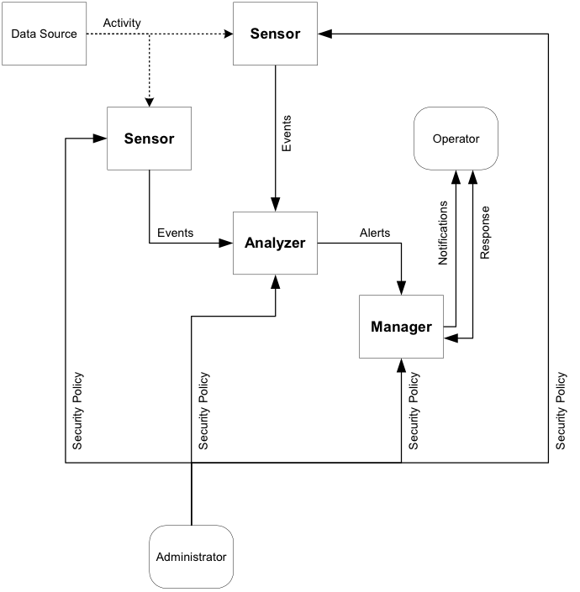
General IDS Model

Slide 13
IDS Architecture
Centralized
Data collected from single or multiple hosts
All data shipped to a central location for analysis
Hierarchical
Data collected from multiple hosts
Data is analyzed as it is passed up through the layers
Distributed
Data collected at each host
Distributed analysis of the data

Slide 14
IDS Operation
Off-line
Inspect system logs at set intervals
Report any suspicious activity that was logged
Real-time
Monitor the system continuously
Report suspicious activity as soon as it is detected

Slide 15
Limitations of Host Based Intrusion Detection
No global knowledge or context information
Must run IDS on host being monitored
Overhead
Host compromise = IDS compromise
Recovery options are limited

Slide 16
Limitations of Multi-host Based Intrusion Detection
Much larger volume of data
No information about communications:
Data
Patterns
Centralized detection might be fooled by data cleansing
Distributed detection might be fooled by lack of agreement

Slide 17
Limitations of Network Based Intrusion Detection
Network data rates are very high
Encryption of network traffic is becoming more popular
Switched environments are becoming more popular
Difficult to insure that network IDS sees the same data as the end hosts

Slide 18
3, Network Intrusion Attacks

Slide 19
ICMP
ICMP: Internet Control Message Protocol
Conceived as an innocuous method of
reporting error conditions and
issuing and responding to simple requests.
A relatively simple protocol but have been used for evil purpose.

Slide 20
Why do we need ICMP?
Simple means of communication between hosts or between host and router,
Not necessarily have to be reliable,
No need to acknowledge,
No particular port to communicate to,
Error conditions from host or router,

Slide 21
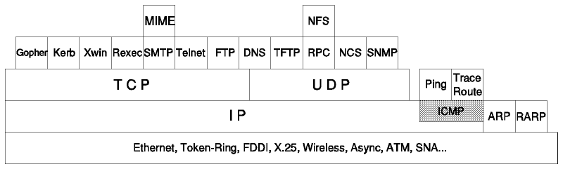
ICMP

Slide 22
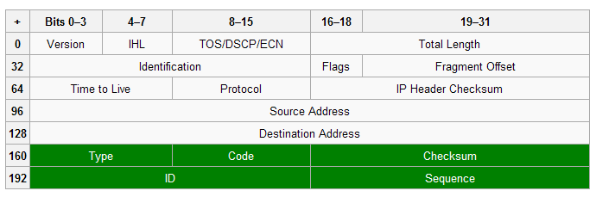
ICMP Header
The grey cells describe the IP header. The ICMP header consists of the green cells.

Slide 23
Malicious ICMP Activity
Smurf Attack
Tribe Flood Network (TFN)
WinFreeze
Loki

Slide 24
DDoS
A DoS attack is an attempt to make a computer resource unavailable to its intended users.
Although the means to, motives for and targets of a DoS attack may vary, it generally comprises the concerted, malevolent efforts of a person or persons to prevent an Internet site or service from functioning efficiently or at all.

Slide 25
DDoS

Slide 26
DNS Backbone DDoS Attacks
The DNS Backbone DDoS Attacks have been several significant Internet events in which distributed denial of service attacks (DDoS) have targeted one or more of the thirteen DNS root servers.
As the nameservers provide this service for DNS lookups worldwide, attacks against the root nameservers are attempts to disable the Internet itself, rather than specific websites.

Slide 27
Smurf

Slide 28
Smurf
The smurf attack is a denial-of-service attack that uses spoofed broadcast ping messages to flood a target system.
A perpetrator sends a large amount of ICMP echo (ping) traffic to IP broadcast addresses with a spoofed source address of the intended victim.
If the routing device delivering traffic to those broadcast addresses performs the IP broadcast to layer 2 broadcast function, most hosts on that IP network will take the ICMP echo request and reply to it with an echo reply, multiplying the traffic by the number of hosts responding.

Slide 29
Tribe Flood Network (TFN)

Slide 30
TFN
Establish a TFN master host and daemon hosts (previously compromised hosts).
The daemons can send the target host
A UDP flood
A TCP SYN flood
An ICMP echo request flood
The master communicates with the daemons using echo reply.
The data portion of the ICMP echo reply is used to send arguments

Slide 31
WinFreeze
Self-mutilation,
WindowsNT
The ICMP redirect message informs a host (victim) that it has tried to use a non-optimal router and tells it to add itself as a router.
Router > victim.com: icmp: redirect 111.222.33.44 to host victim.com
Router > victim.com: icmp: redirect 112.333.33.44 to host victim.com
Router > victim.com: icmp: redirect 113.444.33.44 to host victim.com
Router > victim.com: icmp: redirect 114.555.33.44 to host victim.com

Slide 32
Loki
Loki: god of trickery and mischief.
It uses ICMP as a tunneling protocol for a covert channel.
Data communicated between client/server are stored in the data field of an ICMP packet.
Loki server must be installed first.
Firewall must allow the ICMP traffic to go through.
This is used as a back door into a Unix system after root access has been compromised.

Slide 33
Why not block all ICMP?
There are some sites that do that.
Cannot Ping any more.
No more traceroute or tracert command. Some Unix traceroute uses UDP protocol.
If a host is unreachable, we have to repeatedly try to contact it until timed out.
Blocking only inbound echo request is not enough.

Slide 34
TCP/IP Weaknesses
Memory exhaustion
When TCP was designed in 1970’s, a server have only a few megabytes of memory.
SYN flooding
TCP hijacking

Slide 35
Typical IP stack
TCP is connection-oriented, so it has to maintain states and sequence numbers.
An IP record in C from a Unix workstation:
Header length
Version
Protocol
Type of service
Length
Id
Source and Destination

Slide 36
IP record
struct ip{
#if defined(bsd)
u_char ip_hl:4,
ip_v:4;
#endif
#if defined(powerpc)
u_char ip_v:4,
ip_hl:4;
#endif
u_char ip_tos;
short ip_len;
u_short ip_id;
short ip_off;
#define IP_DF 0x3000
#define IP_MF 0x4000
// don’t frag and more frag
u_char ip_ttl;
u_char ip_p;
u_short ip_sum;
struct in_addr ip_src,
ip_dst;
// source and destination
}

Slide 37
What does it take to SYN?
Each time a new connection is processed, structures (such as ip and socket) have to be created to store information.
That takes memory.
Once a server replies to a SYN, it has committed memory to it until:
FIN (normal exit)
Timed out (~60 seconds) if not ACK’ed

Slide 38
SYN Flooding
Since memory is finite, the designers set limits on the connection stack/queue.
An unpatched Solaris 2.5 with a GB memory will be DoS’ed after 32 SYNs.
Memory is not much of a problem nowaday.

Slide 39
Three-way handshake

Slide 40
Sequence Numbers

Slide 41
SYN Attack

Slide 42
SYN Flooding
Attacker has no intention to complete the three-way handshake,
The goal is to exceed the limits set for the number of connections for a given services, (100 to 1,000 now),
The source address are generally spoofed.

Slide 43
SYN

Slide 44
Mitnick Attack
The goal was to silence one side of a TCP connection, and
Masquerade as the silenced, trusted party.

Slide 45
Mitnick

Slide 46
Recon Probes
Finger: tells you who is logged on, where they are from, idle time, etc.
Showmount: provides info about the file systems mounted with NFS including systems that are world readable and writable.
Rpcinfo: rovide info about the remotre procedure call services and their port number.

Slide 47
Network Trace
Attacker
X-terminal.shell
appolo.it.luc.edu

Slide 48
Network Trace
Seq# 999

Slide 49
Network Trace
Seq# 999
Seq# 999+1

Slide 50
Network Trace
Seq# 999
Seq# 999+1
??? Reset

Slide 51
Sample Trace
14:18:25.906002 apollo.it.luc.edu.1000> x-terminal.shell: S 1382726990:1382726990(0) win 4096
14:18:26.094731 x-terminal.shell> apollo.it.luc.edu.1000: S 2021824000:2021824000(0) ack 1382726991 win 4096
14:18:26.172394 apollo.it.luc.edu.1000> x-terminal.shell: R 1382726991:1382726991(0) win 4096
14:18:27.906002 apollo.it.luc.edu.1000> x-terminal.shell: S 1382726991:1382726991(0) win 4096
14:18:28.094731 x-terminal.shell> apollo.it.luc.edu.1000: S 2021952000:2021952000(0) ack 1382726992 win 4096
14:18:28.172394 apollo.it.luc.edu.1000> x-terminal.shell: R 1382726992:1382726992(0) win 4096

Slide 52
Sample Trace
14:18:25.906002 apollo.it.luc.edu.1000> x-terminal.shell: S 1382726990:1382726990(0) win 4096
14:18:26.094731 x-terminal.shell> apollo.it.luc.edu.1000: S 2021824000:2021824000(0) ack 1382726991 win 4096
14:18:26.172394 apollo.it.luc.edu.1000> x-terminal.shell: R 1382726991:1382726991(0) win 4096
14:18:27.906002 apollo.it.luc.edu.1000> x-terminal.shell: S 1382726991:1382726991(0) win 4096
14:18:28.094731 x-terminal.shell> apollo.it.luc.edu.1000: S 2021952000:2021952000(0) ack 1382726992 win 4096
14:18:28.172394 apollo.it.luc.edu.1000> x-terminal.shell: R 1382726992:1382726992(0) win 4096
128,000

Slide 53
Network Trace
Repeating the probe several more time, we can predict the sequence number.
If we send a SYN to x-terminal, its sequence number should be 128,000 higher (if there is no other SYN in between).

Slide 54
Mitnick
victim
server

Slide 55
Mitnick
“victim” trusts “server”.
“Hacker” contact victim with a spoofed IP of server.
Hacker SYN flood server, making it unable to respond.
Hacker ACK victim with predicted sequence number and gain the trust of the victim.
The Hacker is in.

Slide 56
Detection
Firewall blocks finger, rpcinfo etc.
Many OS now randomize the sequence number.

Slide 57
Buffer Overflow
The most notorious security problem.
Not related to network protocols.
C/C++ does not check memory bounds.
One may overwrite:
Return address
System command executed inside a program (with root permissions)

Slide 58
C code
void function (int a, int b){
char buffer1[5];
char buffer2[10];
}
int main(){
function(1,2);
}
buffer2
buffer1
FP
RA
a
b

Slide 59
Countermeasures
Write secured code.
Your program uses many library function such as strcpy() that does not check boundary.
Use compiler tools to give you warning messages.

